Slide 1
Capstone project - Telecom Customer Churn
Prakul Garg

Slide 2
Agenda
Problem Statement
Objective & KPIs
Implementation
Data Visualization
Exploratory Data Analysis
Feature Importance
Feature Engineering
Setting a baseline
Assess multiple algorithms
Hyperparameter tuning
Performance
Drawing conclusions - Summary

Slide 3
Problem Statement
Due to increasing churn rate of customers from last several quarters, the company has decided to dive deep into factors driving it. Past efforts in retaining customers have been reactive where the suggested steps were applied at the point of no return. The idea is to use machine learning to predict the likelihood of churn for each customer and reasons behind it. These reasons could be different for each customer. This will help with targeted response tailored to customer’s preferences thereby helping them stay and improving customer loyalty.

Slide 4
Objective & KPI
The idea is to build a model to predict how likely a customer will churn by analyzing its characteristics:
Demographic information
Account information
Services information
Key Performance Indicator
High Accuracy Score of the Model
Confusion matrix
High TP and TN rates
Low FP and FN rates
The objective is to obtain a data-driven solution that will allow us to reduce churn rates and, as a consequence, to increase customer satisfaction and corporation revenue.

Slide 5
Implementation
Exploratory Data Analysis
Data Visualization
Feature Engineering
Assess Multiple Algorithms
Performance
Conclusion
Hyperparameter tuning

Slide 6
Data Set
The dataset “Telco_Customer_Churn.csv” contains 19 independent variables
Demographic Information
Gender (M, F)
Customer Account information
Tenure: # of months (Numeric value)
Service Information
Phone Service (Yes, No)
Multiple Lines (No Phone, Yes, No)
Senior citizen (0,1)
Partner (Yes, No)
Dependents(Yes, No)
Payment Method (Electronic check, Mailed check, Bank transfer (automatic), Credit Card (automatic))
Contract (Month-to-month, One Year, Two Year)
Paperless Billing (Yes, No)
Monthly Charges: Amount (Numeric Value)
Total Charges: Amount (Numeric Value)
Internet Services (DSL, Fiber optic, No)
Online Security: (No internet service, No, Yes)
Online Backup (No internet service, No, Yes)
Device Protection (No internet service, No, Yes)
Tech Support (No internet service, No, Yes)
Streaming TV (No internet service, No, Yes)
Streaming Movies (No internet service, No, Yes)

Slide 7
Data cleaning
Check for missing values/ null values in the data for all the features
Fill the missing value for numerical columns with mean/ median (whichever looks more appropriate as per the feature)
Fill the missing value for categorical column with new value (e.g. “missing value”)
Identify and remove the data that looks incorrect/ contradictory
Check if the data type is correct for each feature, otherwise typecast it to correct type
e.g. “Total Charges” was converted from object type to numerical type
Identify and remove the features that looks irrelevant to predict the churn
e.g. Customer Id column was dropped

Slide 8
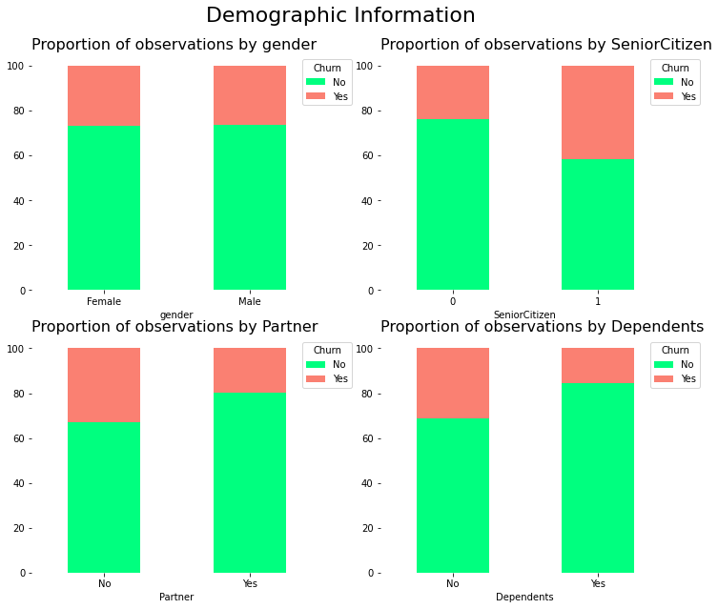
Data Visualization
Visualize the churn with respect to different Demographic features

Slide 9
Demographic Information - Inference
We can extract the following conclusions by analyzing demographic attributes:
The churn rate of senior citizens is almost double that of young citizens.
We do not expect gender to have significant predictive power. A similar percentage of churn is shown both when a customer is a man or a woman.
Customers with a partner churn less than customers with no partner.
Customers with a dependent churn less than customers with no dependents

Slide 10
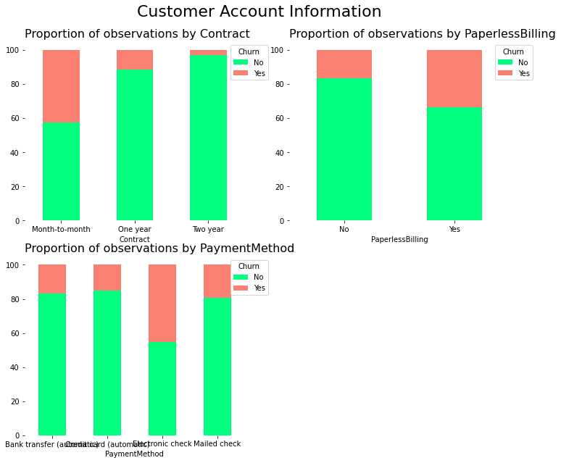
Customer Account Information – Categorical Variables

Slide 11
Customer Account Information - Inference
We can extract the following conclusions by analyzing customer account attributes:
Customers with month-to-month contracts have higher churn rates compared to clients with yearly contracts
Customers who opted for an electronic check as paying method are more likely to leave the company
Customers subscribed to paperless billing churn more than those who are not subscribed

Slide 12
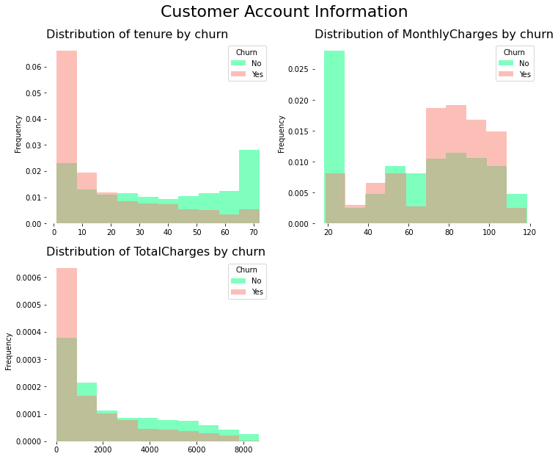
Customer Account Information – Numerical Variables

Slide 13
Customer Account Information - Inference
We can extract the following conclusions by analyzing the histograms:
The churn rate tends to be larger when monthly charges are high.
New customers (low tenure) are more likely to churn.
Clients with high total charges are less likely to leave the company.

Slide 14
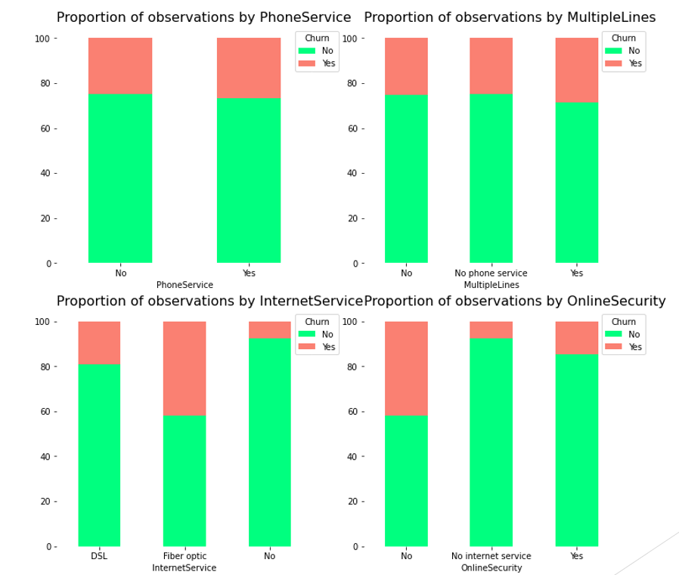
Service Information

Slide 15
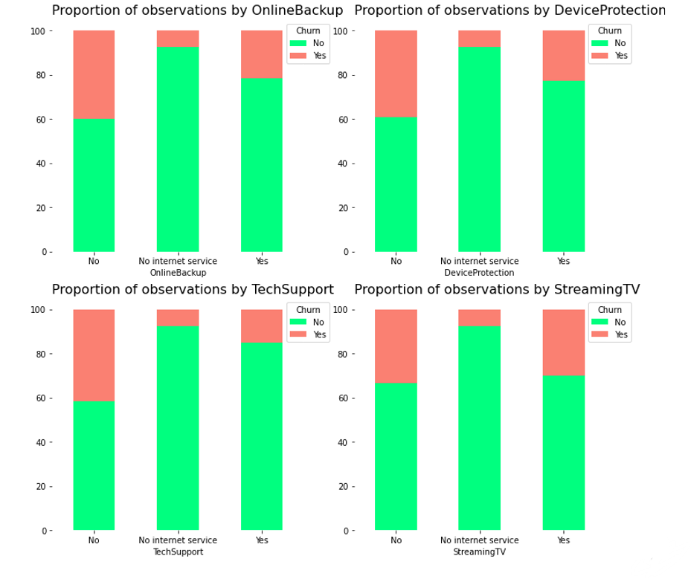
Service Information

Slide 16
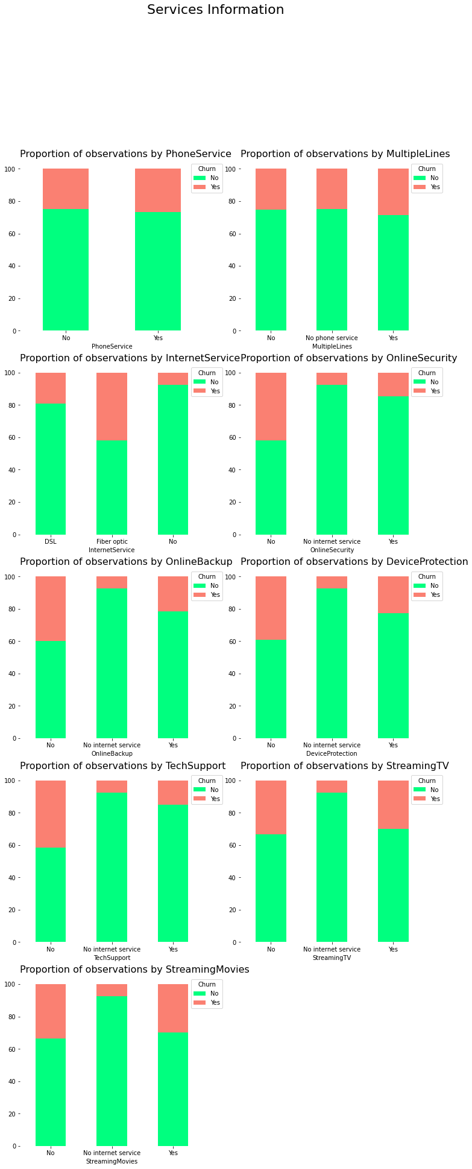
Service Information

Slide 17
Service Information - Inference
We can extract the following conclusions by evaluating services attributes:
We do not expect phone attributes (PhoneService and MultipleLines) to have significant predictive power. The percentage of churn for all classes in both independent variables is nearly the same
Clients with online security churn less than those without it
Customers with no tech support tend to churn more often than those with tech support

